Slide 1

Natural language processing project
By Josh Ho

Slide 2
agenda
Introduction
Project Workflow
Data Preprocessing
Exploratory Data Analysis (EDA)
Text Cleaning
Feature Engineering
Modeling
Model Results

Slide 3
introduction

Slide 4
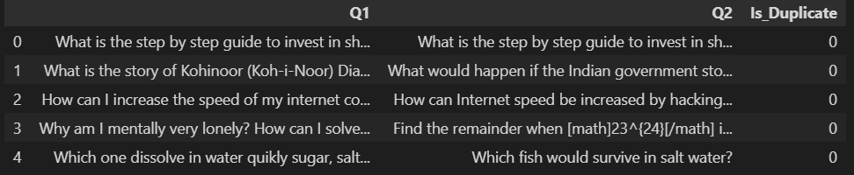

About the data
Unclean CSV file with over 400000 rows of data from Quora, a popular online forum for asking questions
Each row contains a pair of questions, with a column stating whether they are duplicate questions or not (the data is labeled, and has a clear target variable)

Slide 5

Project goal
Users on Quora frequently ask duplicate or very similar questions
Design a model that can determine whether a question that is asked is a duplicate or not
By knowing if a question is a duplicate, we can use a previous answer instead of having somebody re-answer the question from scratch

Slide 6
Project workflow

Slide 7

Project workflow Data preprocessing
Load the dataset
Conduct pre-cleaning:
Removing nulls
Checking for duplicated rows
Dropping irrelevant columns
Renaming columns for readability
Changing all columns to string data type
Removing uppercase
Removing punctuation

Slide 8
Project workflow exploratory data analysis

Slide 9
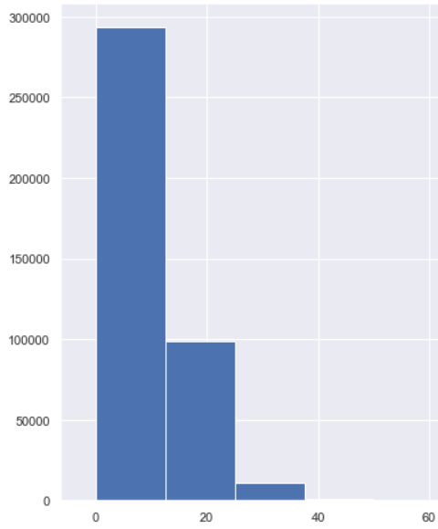
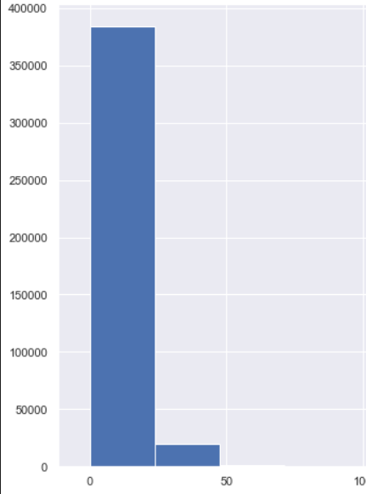
Eda #1 Number of Words in Each Question
Q1
Q2

Slide 10
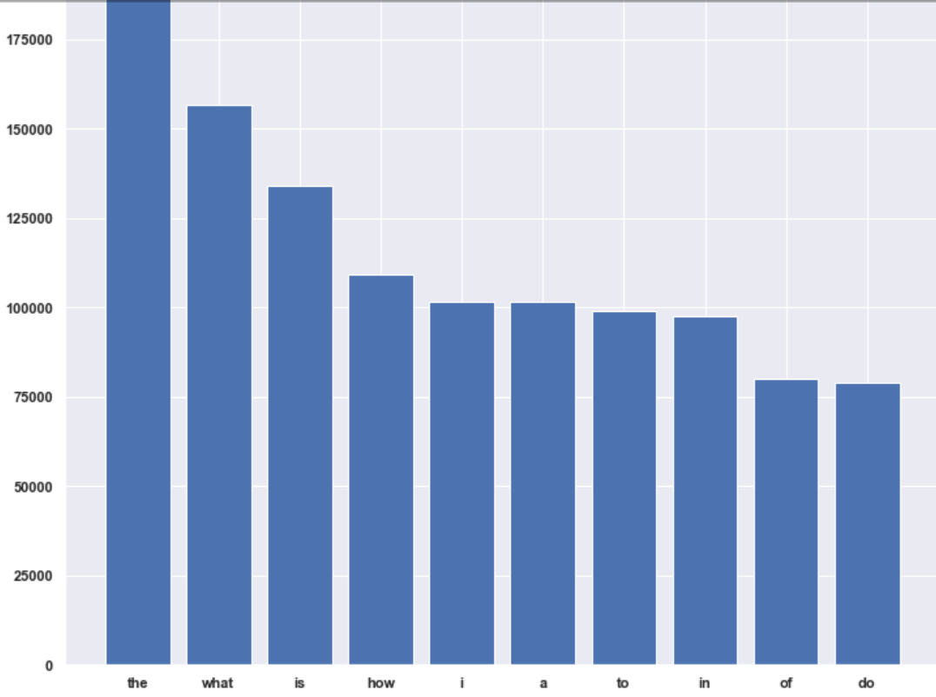
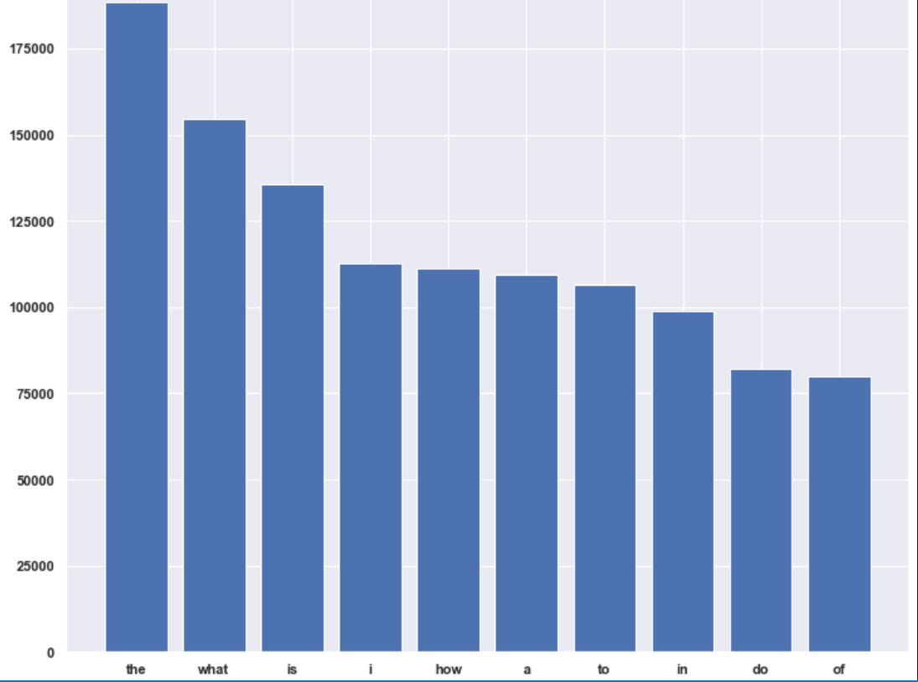
Eda #2 top stopwords
Q1
Q2

Slide 11
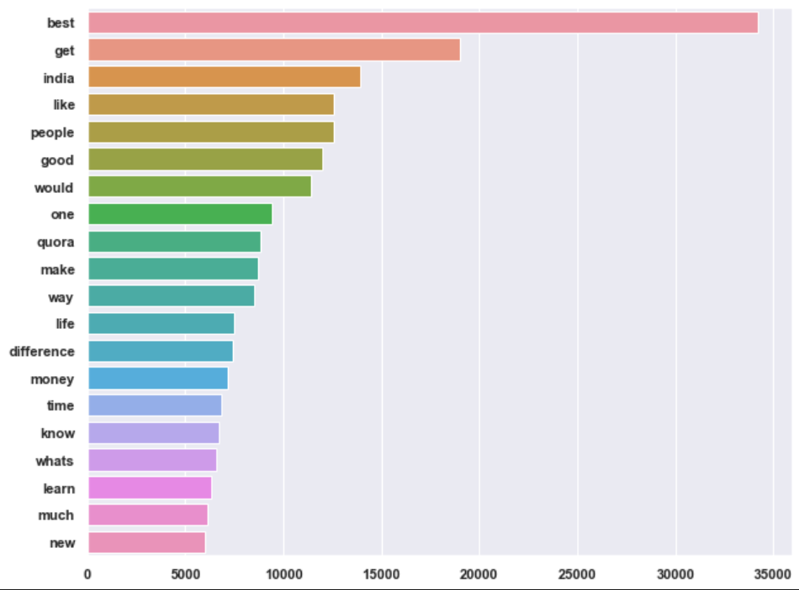
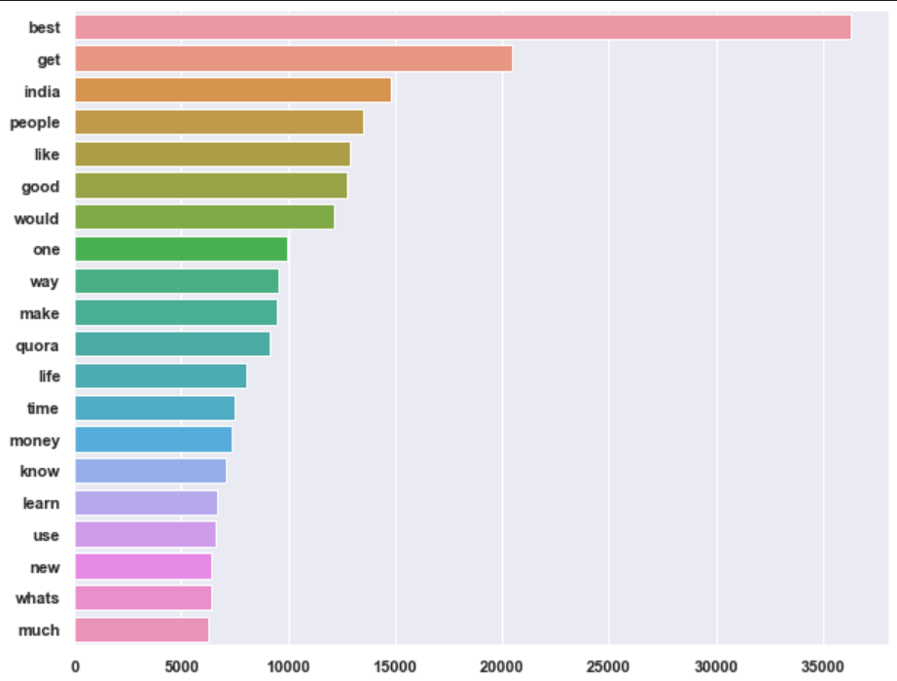
Eda #3 top words
Q1
Q2

Slide 12
Project workflow text cleaning

Slide 13

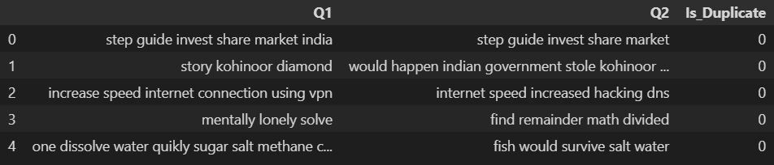
Text cleaning
Tokenization on white spaces (by word)
Removing stopwords
Normalization
Using lemmatization with WordNet Lemmatizer (found more efficient than stemming with Snowball Stemmer)
Removing duplicate words
NLTK
RE

Slide 14
Project workflow feature engineering

Slide 15

Feature engineering
Character count for each question
Word count for each question
Number of same letters between each pair of questions
Number of same words between each pair of questions
Cosine similarity for each pair of questions, derived from text vectorization (TF-IDF vectorizer)
*Scaled with MinMax (except cosine similarity)

Slide 16
Project workflow modeling

Slide 17

modeling
Train test split engineered features (80/20)
Classifiers used for modeling
Logistic Regression
K-Nearest Neighbor
Multinomial Naïve Bayes
Random Forest
Model evaluation
K-Folds Cross-Validation
ROC AUC score

Slide 18
Model results

Slide 19
Model Performances
Logistic Regression
Train Score: 74.38%
Test Score: 74.32%
K-Nearest Neighbor
Train Score: 74.81%
Test Score: 73.31%
Naïve Bayes
Train Score: 72.55%
Test Score: 72.47%
Random Forest
Train Score: 79.56%
Test Score: 77.56%

Slide 20
Thank you for listening!

